Slide 1
Customer Record Administration (Customer Record Administration folder)
Basic Customer Record
CR Statuses
Copy and Transfer
Other Tasks
SMS/800 ® is a registered trademark of SMS/800, Inc.
Notes:
Once a Toll Free number has been reserved, a CAD has to be built to activate the number. This module covers the following:
(Click) Basic Customer Record,
(Click) the 10 Customer Record Statuses,
(Click) How to Copy and Transfer a CR,
(Click) and several other tasks.
(Click)

Slide 2
Customer Record Structure (Three Parts)
The CAD Window contains information on the basic structure of the Dial Number service, including such information as:
1. Customer Name
2. Terminating lines used for the Dial number.
3. Areas-of-Service (Who can call)
4. Simple Call Routing Data (Carrier)
5. Directory Listing Information – (no connection to AT&T DA)
Notes:
There are 3 parts of a customer record. The CAD, CPR and LAD.
(Click) The CAD is always required.
(Click) The CPR and LAD are available (optional) for more complex provisioning of a number.
(Click)

Slide 3
Customer Records that Need Only a CAD
A Customer Record requires only a CAD if it meets all the following criteria:
1. There is no more than one InterLATA Carrier.
2. There is no more than one IntraLATA Carrier.
3. In the Number (Destination Telephone Number) field, there is:
only one POTS number, or
only a Dial Number Turnaround number, or
one POTS number and a Dial Number Turnaround number.
Notes:
Some Customer Records need only a CAD. If all of the following are true then a CAD is sufficient.
(Click) There is no more than 1 Interlata carrier
(Click) There is no more than 1 Intralata carrier
(Click) In the Destination Tel # field there is:
(Click) only 1 POTS destination number.
(Click) Only 1 Dial#. Or
(Click) Only 1 of each…
(Click)

Slide 4
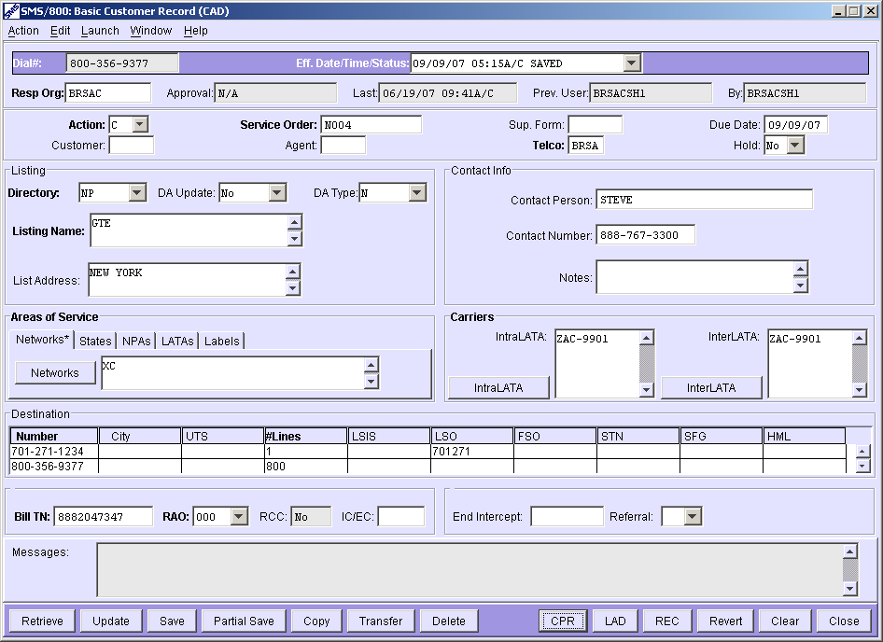
CAD Window
Notes:
Here is the view of a simple CAD window.
(Click) One intralata carrer,
(Click) One interlata carrier,
(Click) One POTs and One Dial#.

Slide 5
CAD - Dial Number & Resp Org
Dial Number | Toll-Free Number
Effective Date/Time/Status | Used to Enter Date/time (15 min time segments) or select from multiple customer records.
Resp Org | Populated – Resp Org that controls the customer record.
Approval - Populated/Protected | Carrier - Approval Status. (Not Req, Await, Denied, NA)
Last - Populated/Protected | Date and Time of the last update/save.
Prev. User - Populated/Protected | Previous non-mass ID to update/save the record.
By - Populated/Protected | Logon ID of most recent person (or mass change) to update/save the record. May be populated with **SCPL**, **UPDT** or *SCPAOS* due to mass changes.
Notes:
The top 2 rows of the CAD contain the following fields:
(Click) Dial Number – the toll Free Number
(Click) Eff. Date/Time/Status – Used to set the date and time for activation for a new record.
Time is accepted in 15 minute increments: (12:00, 12:15, 12:30, 12:45)
(Click) Resp Org – Auto Populated. This is the Resp Org ID that controls and manages this
number.
(Click) Approval – Carrier Approval status. Can display: Not Req, Await, Denied, NA
(Click) Last – Date and time of the last update/Save.
(Click) Prev. User – Previous non-mass ID to update/save the record
(Click) By – Logon ID of the most recent person (or mass change) to update/save the record.
May display: **UPDT**, **SCPL**, or a Logon ID (i.e. BRSACSH1)… etc.
(Click)

Slide 6
CAD - Service Order & Hold
Required Fields on CAD are Bold (Blue below)
Action | The action being taken. N – New C – Change D – Disconnect R – Change Disconnect
Service Order | The first of 4 to13 characters must be alphabetic.
Sup. Form | Supplemental Form. (Can be alternative for Service Order)
Due Date - Populated | The date that service should begin.
Customer | Indicates an on-line subscriber who may want to access their record.
Agent | Identifies a party acting as an agent for the customer record.
TELCO – Populated | Data equivalent to the first four characters of the Resp Org ID.
Hold | Yes – Record will not go active upon reaching its effective Date.
Notes:
Third and forth row display the following fields:
Action – four options. (N=new, C=change, D=Disconnect, R=Revised Disconnect) Auto populated with an ‘N”, when a new record is created. When a CAD is (Copied) to be changed a manual choice of C is required. When a number is disconnected the D is required, When revising a Disconnect number the R must be selected. (Required field)
Service Order – The first of 4 to13 characters must be alphabetic. (Either SO or Sup. Form must be entered)
Sup. Form. – A 5 character ID that can be used in place of a Service Order.
Due Date – The date that service should begin. Based on the Eff date.
Customer - Indicates an on-line subscriber who may want to access their record.
Agent - Identifies a party acting as an agent for the customer record.
Telco - Data equivalent to the first four characters of the Resp Org ID.
Hold - Yes – Record will not go active upon reaching its effective data/time.

Slide 7
CAD - Listing & Contact Info
Directory (Not connected to the ATT directory assistance) | Directory Assistance NP – Non-Published LI – Published Listing BL – Blocked
DA Update – Populated | Directory Assistance Update
DA Type –Populated | Directory Assistance Type
Listing Name | Directory Assistance Listing Name
List Address | Directory Assistance Listing Address
Contact Person | from NUS screen.
Contact Number | from NUS screen.
Notes | From NUS - To add notes about the customer record.
Notes:
Listing and Contact Info… Several fields in this section of the CAD have to do with Directory Assistance. Remember, DA does not connect to the ATT database.
(Click) Directory options include: NP (not published), LI (Published listing), BL (Blocked).
(Click) DA Update options include: (Yes or No).
(Click) DA Type includes: N (for Normal), G (for Government), and F (for frequently called). Since these fields do not connect with a Directory Assistance database it really doesn’t matter what is in these fields unless you actually call ATT directory assistance and have your number listed and want the CR to display correctly.
(Click) Listing Name is your customer name.
(Click) Address is optional.
(Click) The Contact Person, Contact Number and Notes come from the information part of the NUS when the number was reserved. This can be changed on the CAD if desired.
(Click)

Slide 8
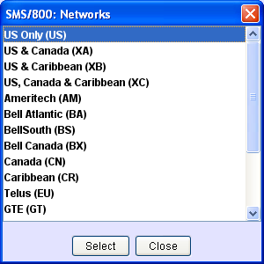
CAD - Areas of Service & Carriers
Networks
CN, CR, AM
IntraLata
InterLata
Areas of Service | Area covered on the customer record.
Network (Codes) | US, XA, XB, XC .… (these 4 are mutually exclusive)
States | AL, AK, AZ …. (Max of 46)
NPAs | By state, 018, 205 …. (Max of 34)
LATAs | 120, 122, 124 …. (Max of 46)
Labels | Area of Service (ASL) Labels (Shorthand) (Max of 16)
IntraLATA Carrier | Required field if service covers IntraLATA (within the LATA) areas. (Max of 20) Separated by commas
InterLATA Carrier | Required field if service covers InterLATA (between LATAs) areas. (Max of 20) Separated by commas
Notes:
Area of Service and Carriers both require an entry for a valid Customer Record.
Area of service defines from what area someone can call this toll free number.
(Click) The Area of Service section contains 5 tabs with their corresponding list buttons and dialogue boxes. There are Three ways to enter data in the data fields; 1. Type in the dialogue box using commas to separate the entries, 2. Double click the entry in the dropdown list. 3. Highlight and click select in the dropdown list.
(Click)
First tab is Network.
(Click) Clicking the Network button under the Network tab, displays a list of 2 digit network codes that can be used to define the Area of Service for this Customer record.
(Click)
The top 4 are mutually exclusive (US, XA, XB, XC).
(Click)
If you enter any one of these 4, you are not allowed to enter anything else in any of the 5 AOS tabs. Any other entry can be used in combination with other entries.
Each tab has a button and dropdown .
(Click) (Click) (Click)
Second tab is States.
(Click) Field requires Two digit codes representing states and Canadian provinces (i.e. AB) and US territories (i.e. PR) (Maximum of 46)
(Click)
Third tab is NPAs.
(Click) The NPAs are listed by state. (Government numbers start with a 0 – i.e. 019) (Maximum of 34)
(Click)
Fourth tab is LATAs.
(Click) Listed in numeric order. (46 LATA limit)
(Click)
Fifth tab is labels.
(Click) Labels are customized shorthand ways to define Area of Service. (i.e. Where a carrier has point of presence POP) Labels are built(defined) on the ASL screen and can be a combination of States, Latas, NPAs, and NPA/NXXs under a single Label name.
(Click)
(Click) The Carriers section allows entries of the ACNA(first 3 Alpha characters) or the 4 digit code. They can be entered by typing in the dialogue box with entries separated by a comma, or by selecting them from the list after pressing the Interlata
(Click) or Intralata
(Click) buttons. (Maximum of 20 for each field)

Slide 9
CAD – Dest. Numbers & End Intercept
Destination Numbers - Numbers used to terminate calls. (Dial# or POTS) (Max of 600)
#Lines - Number of lines (A traffic indicator for the SCP)
LSO - Required for POTs Numbers. (First 6 digits of Pots# - Auto filled)
Billing TN - Number used for billing vertical features (no SMS interface).
RAO - Code of the Revenue Accounting Office (no SMS interface).
RCC - Populated/Protected - Radio Common Carrier. (pager/beeper)
IC/EC - InterExchange Carrier/Exchange Carrier.
End Intercept - (Disco) The date the Customer Record will be deleted from SMS and SCPs.
Referral (Disco) - A “Y” refers callers to another number. An “N” = no referral.
Notes:
This next section of the CAD contains the following entry fields:
(Click) Destination Numbers – The ring to POTS number and/or the Dial#. Up to 600 destination numbers can be entered.
(Click)#Lines – Actually the number of calls that can be taken simultaneously. This is a traffic indicator for the SCP. Large number indicates a high traffic number, etc.
(Click)LSO – (Local Service Office) Required for a POTS number. First 6 characters of the POTS#. Auto filled.
Billing TN – The account number used for billing Vertical features. ( No SMS interface)
(Click)RAO – Identification code of the Revenue Accounting Office (no SMS interface)
(Click)RCC – Radio Common Carrier. (pager and beeper service) Auto populated for those numbers assigned to RCC.
(Click)IC/EC – Inter exchange and Exchange carrier indicator.
(Click)End Intercept – Used when Disconnecting a number. Defaults to 4 months but can be changed to a date earlier. On this date the CAD is deleted and pulled from the SCP.
(Click)Referral – Used for a Disconnect number. “Y” provides a recording referring callers to another number. “N” = no referral.

Slide 10
CAD - Action Buttons
Retrieve - Used to display the Customer Record information.
Copy - Brings up Copy window (Ctrl+Y)
Transfer - Brings up Transfer window (Ctrl +T)
Delete - Deletes the entire record (future)
CPR - Used to access the Call Processing Record screen.
LAD - Used to access the Label Definition screen.
REC - Used to access the Record Selection screen.
Revert - Reverts back to the last saved version.
Clear - Clears all fields
Close - Used to Close the CAD window
Notes:
Thirteen Action buttons at the bottom of the CAD screen perform the following functions:
(Click) Retrieve – Displays and refreshes the screen information. Pressing keyboard “Enter” on most screens does the same thing.
(Click) Copy – Brings up the Copy window allowing a copy of the CR.
(Click) Transfer – Brings up the Transfer window allowing a transfer (rescheduling) of a CR.
(Click) Delete – Deletes the entire customer record (CAD, CPR and LAD)
(Click) CPR – Takes the user to the CPR for this TOLL FREE number.
(Click) LAD – Takes the user to the LAD for this Toll Free number.
(Click) REC – Takes the user to the REC (Record Selection) Screen
(Click) Revert – Takes the user back to the last saved version of the record.
(Click) Clear – Clears all fields of the CAD
(Click) Close – Closes the CAD window.
(Click)

Slide 11
CAD - Partial Save, Save, Update Buttons
Partial Save - Used when the CAD is missing Required Field Information. Results in a CR status of “SAVED”.
Partial Save will save all 3 parts (CAD,CPR,LAD) of the CR.
Save - Used to save the entire record when the Required fields of the CAD are completed. Save does a minor validation of field entries.
If “Transaction Failed” is displayed in Messages, then search the message fields on CAD, CPR and/or LAD to find what is incorrect. Successful Save will result in a CR status of “SAVED”. (Message field displays “transaction completed)
Update - Used when your customer record is complete and you are ready to check all fields with the tables in the background of SMS/800.
Successful Update will result in a CR status of “PENDING”.
Notes:
Three buttons that were not included in the previous slide are the 3 ways to Save your information.
(Click) Update, Save, Partial Save…
(Click) Partial Save – Use this button when you want to save what you have typed even though you don’t have all the Required fields filled out. Results in a Saved status for all parts of a CR.
(Click) Save – Allowed only after all the Required fields are filled out. Saves all parts of the CAD. Minor validation of field entries.
(Click) If Transaction Failed message is returned the save did not happen. Look in the message field of all parts of the CAD to see which screen has the error. Looking for “Transaction Completed” message.
(Click) Update – Used when your customer record is complete and you want to check all field entries with the tables of SMS/800. Successful update results in a status of “Pending”. If errors are found the status will display “Invalid”.
(Click)

Slide 12
CAD - Transaction Failed Message
Transaction Failed…Review the CAD,CPR and LAD to find the screen containing the error causing the Transaction failed. (Save did not happen) The error message only appears on the screen containing the error.
Notes:
(Click)
If you get a “Transaction Failed” message in the message field, the Save, Partial Save, Update did not happen.
(Click) (Click) Check the message field of CAD, CPR and LAD to see the reason. If you use the CAD,CPR and LAD buttons you will need to select the Save, Partial Save or Update button again to see the message. The reason(error) only appears on the screen with the error.

Slide 13
CAD – Warning Messages
Errors – Cause CR status of Invalid. Warnings – Will not cause Invalid CR
After UPDATE, 3 Common “Warning” messages will not cause record to go INVALID. (IGNORE)
Notes:
After an Update you may see warnings in the message box.
(Click) When a message begins with “warning” it is not an error that will cause the record to go invalid. Three common warning messages in Tutorial that will not cause INVALID are:
(Click)
1. NPA split in your area coming soon… (Just a notification that an NPA you have listed in your record is scheduled to be changed in the near future)
2. RAO coded does not belong… (Since RAO codes are not sent to any database and do not identify relevant information I have you enter 000 causing this warning.
3. CIC 0110 is not used…Like an advertisement for the LEC. “Use your LEC to carry this traffic.”
(Click)
Errors – Cause CR status of Invalid. Warnings – Will not cause Invalid CR (Just ignore these messages while working in Tutorial)
(Click)

Slide 14
Customer Record Statuses
1. Saved - Not yet validated. (Save or Partial Save button)
2. Pending - Passed validation, future active. (up to 6 Months in future) (Update)
3. Sending - At least one SCP hasn’t responded. (one SCP has)
4. Active - Working
5. Old - Replaced by Active/Sending or Disconnect.
6. Invalid - Didn’t pass Validation after Update.
7. Disconnect - Normal service discontinued.
8. Must Check - Needs to be checked and Updated.
9. Failed - When Effective Date/time reached and CR is not PENDING. (All SCPs reject record – record too large)
10. Hold - Hold DD has a Y (yes). Not sent to SCP.
Notes:
Customer Record Statuses – There are 10 CR statuses that are found in the top center “EffDateTimeStatus” field of a Customer Record CAD, CPR or LAD.
(Click) 1.Saved – A customer record where either a “Save or Partial Save” has been performed.
(Click) 2.Pending – A CR where Update has been performed and no errors are found. A Pending record is ready to be sent to the SCP.
(Click) 3.Sending – A CR that has reached its EFF date and time and is sent to the SCPs. CR must be in a Pending Status right at the Eff date and time moment. At least one SCP has accepted the CR and at least one has not loaded it yet.
(Click) 4.Active – A CR that is loaded at all the SCPs in its area of service.
(Click) 5.Old – A former Disco, Sending or Active CR that has been replaced by a new CR.
(Click) 6.Invalid - If errors are found in a CR after an Update the status changes to Invalid.
(Click) 7.Disconnect – A CR that has normal service discontinued.
(Click) 8.Must Check – A CR needing to be checked and Updated for various reasons.
(Click) 9.Failed – When the Eff Date/time is reached and the Status does not say PENDING. Or when all the SCPs reject a CR. (happens when a CR is too large)
(Click) 10.Hold – When the Hold DD field has a Y (yes) selected. When the eff date/time is reached it is not sent to the SCP.
(Click)

Slide 15
Data Base Partitions
Numb Admin
Cust Record
Reports
Activity Log
CNA
Security
SCP Admin
Network Adm
SMS Tables
Resp Org
Mail
Other
The SMS/800 Database is divided up into many Partitions. Each Partiton has its own unique interaction with the other partitions. (I.e. CR Statuses overlap the NA Statuses)
NA - Number Administration
CR - Customer Records
Notes:
Data Base Partitions…
(Click) The SMS/800 Database is divided up into many Partitions.
(Click) Each Partiton has its own unique interaction with the other partitions.
(Click) (I.e. CR Statuses overlap the NA Statuses)
(Click) (Click)

Slide 16
Status Comparison
CR Status – CAD,CPR,LAD | NA Status – NUS (Q4) | Search Results Process Status NUS (Q2)
1. Saved | 1. Spare | 1. Waiting
2. Pending | 2. Reserved | 2. Reserved
3. Sending | 3. Working | 3. In Use
4. Active | 4. Suspend | 4. On Hold
5. Old | 5. Unavailable (any CR Status) | 5. Failed
6. Invalid | 6. Assigned | 6. Closed
7. Disconnect | 7. Disconnect
8. Must Check | 8. Transitional
9. Failed
10. Hold
Notes:
There are 3 different types of statuses found in 3 separate partitions of WBA: CR status, NA status and Search Results Status.
(Click) CR status – Found in the Eff Date/time/Status at the top of a CAD/CPR or LAD after a CR has been created.
(Click) NA status – (Number Admin status) found in Quadrant 4 of the NUS after selecting ‘Get Info”.
(Click) Search Results Status – When a Search or Reserve is performed these statuses appear next to the number in Quadrant 2 of the NUS.
(Click)

Slide 17
CR Status Clean-Up
HOLD, PENDING, FAILED, MUST CHECK, INVALID, SAVED and OLD
“Past Due” Records :
If the “Past Due” Record is followed by another record with status of: ACTIVE, SENDING, DISCO, or OLD. Then at least 1 day [tunable **] must have passed since the Effective Date before it is deleted.
If the “Past Due” Record is followed by another record with a status of SAVED, PENDING, HOLD, FAILED, INVALID, OR MUST CHECK. Then at least 30 days must have passed since the Effective Date before it is deleted.
If an OLD Record is followed by another record and at least 1 day [tunable **] has passed since the record became OLD, then the record will be deleted.
If the OLD Record is the only record for the Dial# it will remain at least 30 days before it is deleted and then this Dial# will be returned to Spare.
NOTE: If only 1 record exists for a Dial# and it is not ‘OLD’ status, then it will not be removed.
** This parameter is adjustable by SMS/800 Data Center from 1 day to 9 days. This cleanup process can be run as frequently as every day to once every 2 weeks (currently once a week adjustable by the Data Center).
Notes:
Numbers that are past due will be cleared from the CR list with the following rules:
(Click) If a CR with a past due date and a status of: Hold, Pending, Failed, Must Check, Invalid, Saved or Old is followed by an Active, Sending, Disco or Old, then the CR with the past due date will be deleted after 1 day.
(Click) If a CR with a past due date and a status of: Hold, Pending, Failed, Must Check, Invalid, Saved or Old is followed by a Saved, Pending, Hold. Failed, Invalid, or Must Check then at least 30 days must pass before it is deleted.
(Click) An Old record will be deleted after 1 day in “OLD” status if it is followed by another record.
(Click) If an “OLD” status record is the only record 30 days must pass before it is deleted.
A single CR that is not in “OLD” status will not be deleted.
(Click) This is adjustable from 1 to 9 days by the SMS/800 Data center. Job is run once a week.
(Click)

Slide 18
Views and Permissions for the CAD
SMS/800 Help Desk – View and Update all info.
Control Resp Org
Can view and modify all information in a customer record under their Resp Org ID.
Involved Routing Carrier
Can view only the information pertaining to its own CIC call routing.
Data in the INTRALATA and/or INTERLATA Carriers fields is viewable only if the involved routing carrier is an intralata or interlata carrier.
Several data fields, such as Listing, are not viewable to the involved routing carrier. The field names appear with no data next to them.
Notes:
Views and Permissions for the CAD window.
(Click) The SMS/800 Help Desk can view and update all info. For example they can view and update any ROs CAD, CPR or LAD data. We prefer not to.
(Click) The Control RO can only view and update CRs that are under their RO id or for which their 6a gives them permission.
(Click) The involved Carrier (Inter or Intra Lata carrier) can access and see only their information on CADs where they are listed. Several fields: i.e. DA listing are not viewable.
(Click)

Slide 19
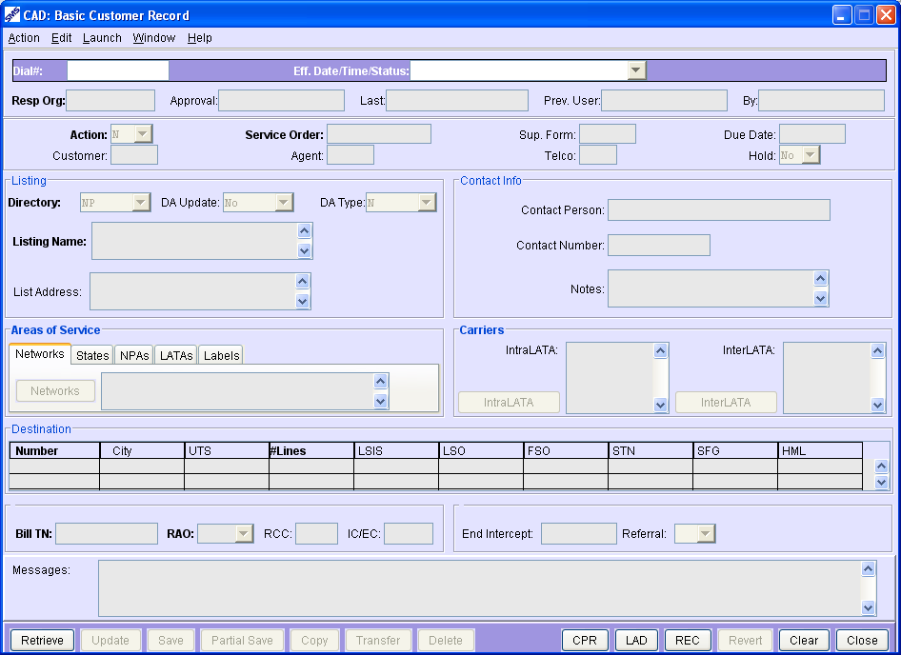
Access a Customer Record
1. Type the Dial Number in the Dial# field.
2. Click the Retrieve button or press Enter on Keyboard.
Note
To retrieve a different Customer Record with a different Effective Date/Time/Status, select the required status from the drop-down menu and click the Retrieve button again.
8887776666
3/4/10 10:00 a/c Active
3/7/10 11:00 a/c Pending
3/9/10 12:15 a/c Saved
Notes:
To Access a specific CAD, Bring up a blank CAD
(Click)
type the # in the Dial# field
(Click) (Click)
press enter or select retrieve.
(Click) (Click)
If the user wants to access a different CAD for this Toll Free
(Click) select it from the Effdate/time/status dropdown and retrieve.
(Click)
(Click)

Slide 20
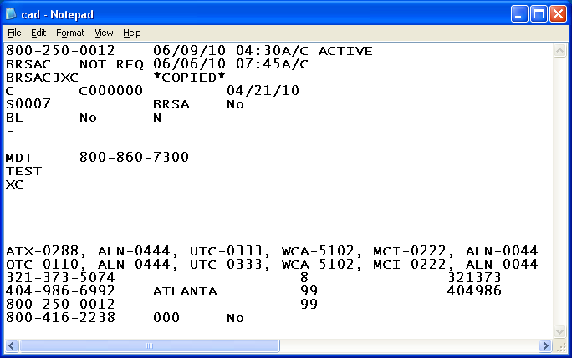
Save as File a Customer Record
1. Type the Dial Number in the CAD Dial # field.
2. Click the Retrieve button.
Select and
Retrieve the
correct
Record.
Select “Save as
File” from the
Menu under
Action
Notes:
A user can Save the information from the CAD as a .txt file.
(Click) Select Action menu and
(Click) ‘save as file’ option.
(Click) the Text file will be saved with the CAD information.
(Click)

Slide 21
Establishing New Service
1. Access the Blank CAD Window.
2. Type the Dial Number and Effective Date/Time of the new record. (If Time not entered, SMS will select a time)
3. Press the Retrieve button.
4. Enter the required information.
5. Press the Save or Update button.
6. Observe Messages and Eff Date/Time/Status
8887776666
3/7/10 11:00 a/c
Name
9901 9902
US
8887776666 99
Messages….Warnings….Errors
1. Type Dial# 2. Eff Date/time 3. Enter/Retrieve
Notes:
To establish new service (Build a new CAD), bring up a blank CAD
(Click) (Click)
Type the Dial#
(Click) (Click)
Type the Eff Date/time in the top center field of that name.
(Click) (Click)
If time is not entered, SMS/800 will select a 15 minute window during the least busy time of SMS/800 for that date.
(Click) Select the Retrieve or press Enter on your Keyboard.
(Click) (Click)
Enter data in the required fields that are BOLD.
(Click) (Click)
Press Partial Save, Save or Update.
(Click) (Click)
Check the messages field to see what needs to be done to correct your CAD.
(Click) (Click)
Always let your First Three Steps be: 1. Type Dial# 2. Type Eff Date/time 3. Enter/Retrieve
(Click)
(Click)

Slide 22
Changing Existing Service
1. Access a blank CAD Window.
2. Type the Dial Number
3. Press the Retrieve button.
4. Select the Effective Date/Time/Status for a Future record.
(If no future record, then copy forward)
5. Enter the data changes on the CAD window.
6. Press the Update button.
7. Observe Messages and Eff Date/Time/Status
Notes:
To Change Existing Service the CAD must have a future Eff Date. Bring up a Blank CAD.
(Click)
Enter Dial# and Retrieve or press enter.
(Click)
Look in the Eff Date/time drop down. If a future record exists, select it and retrieve.
(Click)
(Click) (Click)
If no future record, copy the record forward or to NOW to make changes. Enter the changes and press Update.
(Click)
Observe messages field, make corrections and continue to update until record displays PENDING. (Pending means the CR passed all validations)
(Click)

Slide 23
Copying a Customer Record
1. Access the CAD Window.
2. Select and Retrieve the source record.
3. Click the Copy button or use Ctrl+Y
4. Enter the Dial Number and Effective Date/Time of the Target record in the Copy window.
5. Select the portions of the record to copy.
6. Click the Perform Copy button.
1. NOW (current 15 min. window)
2. Forward (future)
3. Backward (between older and current CR)
Notes:
(Click) To Copy a Customer Record bring up the CAD of a specific number
(Click) Select and Retrieve the Base (source) Record.
(Click) Click the Copy button or use Ctrl+Y
(Click) (Click) (Click) In the Copy window are displayed the Source Record
(Click) and the Target Record.
(Click) (Click) Confirm or Enter the Toll Free Number and Eff date/time where you want the info copied to. Default is the same number as the Source Record.
(Click) (Click) Eff Date/time can be NOW (current 15 min window), Forward (up to 6 months), Backward (between an older record date and the current record date)
(Click) (Click) Select the portions of the record to be copied.
((Click) Click the perform copy button.
(Click)

Slide 24
Guidelines for the CAD Copy Window
If the Target Dial Number is not provided, then the default is the Source Dial Number.
If the Target Dial Number is different than the Source Dial Number, the Target Dial Number must be in status of reserved or unavailable.
If the Target Dial Number is different than the Source Dial Number and the Target CAD already exists, then the copy is not allowed.
If the Target Dial Number is the same as the Source Dial Number and the target record does exist, then the user is asked whether to overwrite the existing record.
The Target Effective Date/Time cannot be earlier than the earliest record when doing a copy. Nor can it be in the past.
When doing a copy to “Now” a user can replace the existing record providing the Effective Date/Time is in the current 15 minute period and the Status is not Sending, Active, Disconnect or Old. (already sent to SCPs)
You are not allowed to jump over (leap frog) an earlier or later existing CAD when performing a CAD copy. (Leap frog of CPR,LAD only is allowed)
Effective Date cannot be past 6 months into the future.
Notes:
(Click)
1. If the Target Dial Number is not provided, then the default is the Source Dial Number.
(Click)
2. If the Target Dial Number is different than the Source Dial Number, the Target Dial Number must be in status of reserved or unavailable.
(Click)
3. If the Target Dial Number is different than the Source Dial Number and the Target CAD already exists, then the copy is not allowed.
(Click)
4. If the Target Dial Number is the same as the Source Dial Number and the target record does exist, then the user is asked whether to overwrite the existing record.
(Click)
5. The Target Effective Date/Time cannot be earlier than the earliest record when doing a copy. Nor can it be in the past.
(Click)
6. When doing a copy to “Now” a user can replace the existing record providing the Effective Date/Time is in the current 15 minute period and the Status is not Sending, Active, Disconnect or Old. (already sent to SCPs)
(Click)
7. You are not allowed to jump over (leap frog) an earlier or later existing CAD when performing a CAD copy. (Leap frog of CPR,LAD only is allowed)
(Click)
8. Effective Date cannot be past 6 months into the future.

Slide 25
Leap Frog Rule for CAD
Users are not allowed to jump over an earlier or later existing CAD when doing a copy or transfer.
Examples:
1. Cannot copy the Active CAD to a date past the 5/1/02 Record.
2. Cannot copy the 5/1/02 CAD forward to a date past 6/1/02.
3. Cannot copy the 6/1/02 CAD backward to a date earlier than 5/1/02
Notes:
(Click) Users are not allowed to jump over an earlier or later existing CAD when doing a transfer or copy.
Examples:
(Click) 1. Cannot copy the Active CAD to a date past the 5/1/02 Record.
(Click) 2. Cannot copy the 5/1/02 CAD forward to a date past 6/1/02.
(Click) 3. Cannot copy the 6/1/02 CAD backward to a date earlier than 5/1/02

Slide 26
Transferring a Customer Record
1. Access the CAD Window.
2. Retrieve the required Base record.
3. Click the Transfer button or press Ctrl+T.
4. Enter the Dial Number and Effective Date/Time of the Target record.
5. Select the portions of the record to Transfer.
6. Click the Perform Transfer button.
Forward = future date/time
Backward = earlier date/time
NOW = beginning of Current 15 min window
Notes:
Users can Also Transfer a Customer Record. To Transfer is to Reschedule(change the date) a Record. Similar to cut and Paste. Users can Transfer a record:
(Click) Forward to a future date/time
(Click) Backward to an earlier date/time
(Click) to NOW. The beginning of the current 15 min window.
To Transfer (Reschedule) a record:
(Click) 1. Access the CAD Window.
(Click) 2. Retrieve the required Base record.
(Click) 3. Click the Transfer button or press Ctrl+T.
(Click) 4. Enter the Dial Number and Effective Date/Time of the Target record.
(Click) 5. Select the portions of the record to Transfer.
(Click) 6. Click the Perform Transfer button.
(Click)

Slide 27
Guidelines for the CAD Transfer Window
1. If the Transfer is to a Target CAD date that does not already exist, the record is transferred and the entire source is gone.
2. If the Transfer is to a Target CAD date that already exists, a confirmation message is displayed. (Do you want to overwrite?)
3. If a transfer is denied, an error message is displayed.
4. A record can only be transferred up to six months into the future.
5. A CAD can only be transferred backward to an Effective Date/Time that is later than the Effective Date/Time of the previous input record (Leap-Frog Rule). (or earlier than a future CR)
A previously existing Active, Disconnect or Sending cannot be Transferred.
Notes:
Guidelines for the CAD Transfer window.
(Click) 1. If the Transfer is to a Target CAD date that does not already exist, the record is transferred and the entire source is deleted. (Click) 2. If the Transfer is to a Target CAD date that already exists, a confirmation message is displayed. (Do you want to overwrite?)
(Click) 3. If a transfer is denied, an error message is displayed.
(Click) 4. A record can only be transferred up to six months into the future.
(Click) 5. A CAD can only be transferred backward to an Effective Date/Time that is later than the Effective Date/Time of the previous input record (Leap-Frog Rule). (or earlier than a future CR)
(Click) 6.A previously existing Active, Disconnect or Sending cannot be Transferred.

Slide 28
CAD Copy Allowed?
Action of D or R (not to Reserved)
Transfer only
Notes:
When is a Copy of a CAD allowed?
This table shows 4 columns: CR Status, Action, Target Dila# and Copy allowed.
(Click)
The Action column holds 4 possibilities:
(Click)
N=new, C=change, D=Disconnect, R=Revised Disconnect
(Click) Three CAD statuses never allow a Copy. The Copy button on the CAD will be Grayed out: Invalid, Failed, Must Check.
(Click) (Click)
(Click) The 5 Yellow arrows point to when a Copy of a CAD is NOT allowed. What do these scenarios have in common. What would be the rule for when a Copy is not allowed?
(Click)
Any number with an ACTION of D or R cannot be copied into a brand new Reserved Number.
(Click)

Slide 29
When to Copy or Transfer a CAD
Copy Only:
1. Active
2. Disconnect
3. Sending
Transfer Only:
4. Invalid
5. Must Check
6. Failed
Copy and/or Transfer:
7. Pending
8. Hold
9. Saved
Never Copy or Transfer of CAD:
10. Old (CPR and LAD Copy is allowed)
Immediate Activation 1. Transfer to NOW 2. Update 3. Retrieve
Notes:
Here is a handy page to help a user know when to Copy and Transfer.
(Click) Three CR statuses only allow a Copy: Active, Disconnect and Sending
(Click) Three CR statuses only allow a Transfer: Invalid, Must Check and Failed.
(Click) Three CR statuses allow both a Copy or a Transfer: Pending, Hold and Saved
(Click) The “OLD” status never allows a CAD to be Copied or Transferred.
(Click) Reminder ( When a user wants an immediate activation of a number, they Transfer to NOW, Update and Retrieve.

Slide 30
Deleting a Customer Record
Future Effective Date/Time Pending, Saved, Invalid, Hold, or Must Check can be deleted
Retrieve the record you want to delete.
Press the Delete button at bottom of CAD.
3. Click the Yes to confirm the deletion of the record.
Note: Deleting the CAD deletes the entire customer record. (CAD, CPR and LAD)
Note: If there is only one future record and it is deleted, within the 45 days from being reserved, the Dial Number will be returned to “RESERVED” status. If past the 45 days from being reserved the number will be returned to “SPARE”.
Notes:
(Click) A customer record with a future Effective Date/Time and a status of Pending, Saved, Invalid, Hold, or Must Check can be deleted from the Customer Record screens or from the REC screen.
(Click) 1. Retrieve button.
(Click) 2. Press the Delete button.
(Click) 3. Click the Yes to confirm the deletion the record.
(Click) Note: Deleting the CAD deletes the entire customer record.
(Click) Note: If there is only one future record and it is deleted, within the 45 days from being reserved, the Dial Number will be returned to “RESERVED” status. If past the 45 days from being reserved the number will be returned to “SPARE”.

Slide 31

Changing the Control Resp Org
RO Change – 2 ways
1. By Current RO = Free
2. By SMS/800 Help Desk = Tariff Fee (Must have correct form 10 and LOA)
1. Retrieve a specific future record. (If no future record then copy forward and make RO change)
2. Overwrite the entry in the Resp Org field.
3. Press the Update button. (Save will also finalize change)
Notes:
Changing the Resp Org on a Toll Free that has a CAD.
(Click) If a Toll Free number has a CAD then a Resp org change has to be done from the CR screens (or the MRO Automation screen – to be covered Thursday)
(Click) The Resp org field of a future CR is used to move control of a CR to another company Resp Org ID.
(Click)
There are 2 ways a RO change can be done:
(Click) By the current RO. This process is free. Old RO has 2 business days to complete request.
(Click) By the SMS/800 Help Desk. A tariff fee will be charged. A form 10 and LOA must be submitted.
(Click) The process is first to Retrieve the specific FUTURE record
(Click) Overwrite the entry in the RO field
(Click) Update or Save the record.
(Click)

Slide 32
Disconnecting an Active Record
1. Delete any future Effective Date/Time records.
2. Press the Retrieve button for the Active record.
3. Select the Copy button and copy the record to the Effective Date/Time you want the CR disconnected.
4. Enter “D” in the Action field.
5. Enter “No” or “Yes” in the Referral field. (Referral is
a message from carrier referring caller to a
different number)
6. Enter the End Intercept Date. (default is 4 months)
7. Press the Update button.
Notes:
To Disconnect an Active (Working) Customer Record…
(Click)
1. Delete any future Effective Date/Time records.
(Click)
2. Press the Retrieve button for the Active record.
(Click)
3. Select the Copy button and copy the record to the Effective Date/Time you want the CR disconnected.
(Click)
4. Enter “D” in the Action field.
(Click)
5. Enter “No” or “Yes” in the Referral field. (Referral is
a message from carrier referring caller to a
different number)
(Click)
6. Enter the End Intercept Date. (default is 4 months)
(Click)
7. Press the Update button.
(Click)

Slide 33
Use the REC (Record Selection) to…
— View a list of Customer Records for a single user-entered Dial Number
— View any component of CAD, CPR, or LAD for any Customer Record shown in the retrieved list of Customer Records for a single Dial Number.
— Copy any component of a selected Customer Record of applicable status (Active, Sending, Disco, Hold, Saved, Pending, Old-CPR or LAD)
— Transfer any of the components for a selected Customer Record of applicable status (Failed, Hold, Invalid, Must Check, Pending, Saved)
— Delete a selected Customer Record of applicable status that is shown in the Customer Record list without retrieving.
— Update a selected Customer Record of applicable status that is shown in the Customer Record list without retrieving.
— Print the Customer Record list.
— Convert a CAD to a Pointer PAD and visa versa
Notes:
At the bottom right of the CAD is the REC button. (Record Selection) This feature is useful in the following ways:
(Click)
— View a list of Customer Records for a single user-entered Dial Number
(Click)
— View any component of CAD, CPR, or LAD for any Customer Record shown in the retrieved list of Customer Records for a single Dial Number.
(Click)
— Copy any component of a selected Customer Record of applicable status (Active, Sending, Disco, Hold, Saved, Pending, Old-CPR or LAD)
(Click)
— Transfer any of the components for a selected Customer Record of applicable status (Failed, Hold, Invalid, Must Check, Pending, Saved)
(Click)
— Delete a selected Customer Record of applicable status that is shown in the Customer Record list without retrieving.
(Click)
— Update a selected Customer Record of applicable status that is shown in the Customer Record list without retrieving.
(Click)
— Print the Customer Record list.
(Click)

Slide 34
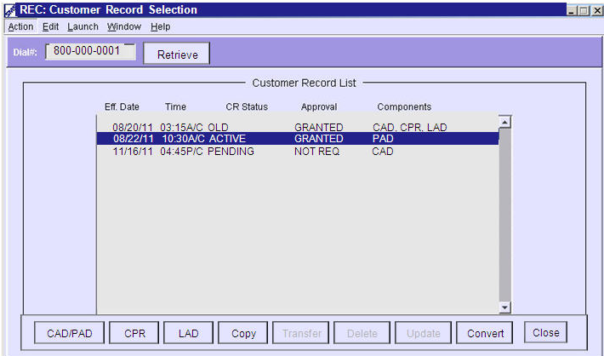
REC (Screen)
Notes:
The REC screen displays a list of all customer records associated with this Toll Free number.
Each CR must have a unique 15 minute window for which it is assigned.
In this example we have an ACTIVE record that went active at 1:45 pm Central time on 9/22/03.
(Click)
We also have a future SAVED record that was set for 5:15 am Central time on 12/12/03.
(Click)
(Click)
By highlighting the records in the list and pressing the individual buttons a user can access the different parts of a CR as well as Copy, Transfer, Delete and Update.

Slide 35
HPU (High Priority Update)
When SCP Queuing occurs and Immediate updates are required… Selecting Menu item “Action -> Update High Priority” when transferring a CR to NOW, puts the record at the top of the Q at the SCP. (10 Updates per day are allowed per RO Entity)
Notes:
In Emergency situations a high Priority update is available.
When SCP Queuing occurs and Immediate updates are required…
(Click)
Selecting Menu item “Action -> Update High Priority” when transferring a CR to NOW,
(Click)
puts the record at the top of the Q at the SCP. (10 Updates per day are allowed per RO Entity)

Slide 36
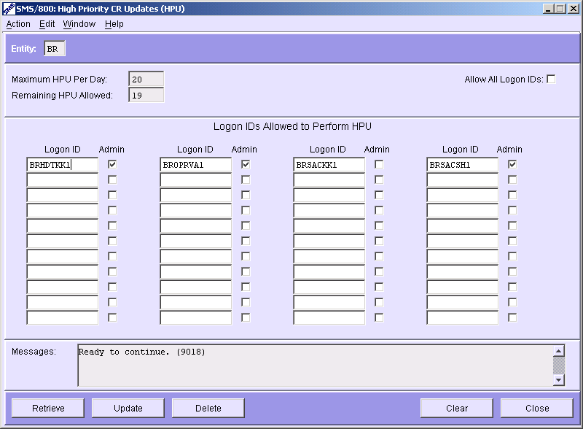
HPU Screen
A checkmark in the “Allow All Logon Ids” field gives all Logon Ids in the RO permission to perform “High Priority Updates”
10
9
HPU screen allows a RO Administrator to add/delete Logon Ids. Logon Ids listed on this screen are given permission to perform High Priority Updates. (10 per day/per RO entity)
Notes:
The HPU screen
HPU screen allows a RO Administrator to add/delete Logon Ids.
(Click)
Logon Ids listed on this screen are given permission to perform High Priority Updates. (10 per day/per RO entity)
(Click)
A checkmark in the “Allow All Logon Ids” field gives all Logon Ids in the RO permission to perform “High Priority Updates”

Slide 37
Num Admin Life Cycle of a Toll Free #
1. Spare
No CR
7. Transitional
2. Reserved
No CR
No CR
6. Suspend
3. Assigned
Pending
Saved
Invalid
Pending
Hold
Failed
Must Check
5. Disconnect
Disconnect
4. Working
8. Unavailable – Can be any CR status
Sending
Active
Notes:
Here is the Life Cycle of a Toll Free Number.
(Click)
The Toll Free starts out as a SPARE number
(Click)
At some time the Number is Reserved by a Resp Org for an end user.
(Click)
Within the Reserved 45 days, a Resp Org builds a Customer Record (CAD) The NA status now becomes Assigned. (If after 45 days a CAD is not built, the Reserved number returns to Spare)
(Click)
When the ASSIGNED number reaches its Eff Date/time the number becomes WORKING.
(Click)
After a long and productive life the working number can be DISCONNECTED.
(Click)
During the 4 month DISCONNECT, the Resp Org can reactive the number by entering a new effective date. Until the new effective date the Number will show SUSPEND status.
(Click)
Once a Disconnected number reaches its End Intercept Date, the number status changes to TRANSITIONAL.
(Click)
When the end of the 4 month disconnect/Trans time is reached the number returns to SPARE.
(Click) When a number is SPARE, there is No CR
(Click) When a number is RESERVED, there is still no CR
(Click) As soon as a CAD is built depending on the action taken and the validity of the update or save the CR can be: Saved, Invalid, Pending, Hold, Failed or Must Check.
(Click) When the PENDING CR reaches its Eff Date/time the CR is sent to the SCP. First it shows SENDING and when all the SCPs have loaded it, the CR displays ACTIVE.
(Click) When the Toll Free number is not longer needed, it is Disconnected. Both the NA and CR status show Disconnect.
(Click) If a reactivation is set up (Suspend) the CR will have both a Disconnect and a future Pending record associated with it.
(Click) If a reactivation is NOT set up, after the CR reaches its End Intercept Date, the CR is deleted (no CR)
(Click) At the end of 4 months (or manually) the Transitional number returns to Spare.

Slide 38
CAD Review
CR Statuses
CR Structure (Parts)
CAD fields
CAD Views
CR New Service
Retrieving CRs
Copying a CR
8. Transferring a CR
9. Deleting a CR
10. Changing the RO of a CR
11. Disconnecting an Active
12. Using the REC
13. HPU (High Priority Update)
Written Exercise CAD #3
Hands-On Exercises CAD (3A-D)
Notes:
Complete the Written and Hands On Exercises for the CAD Module.

